Slide 1
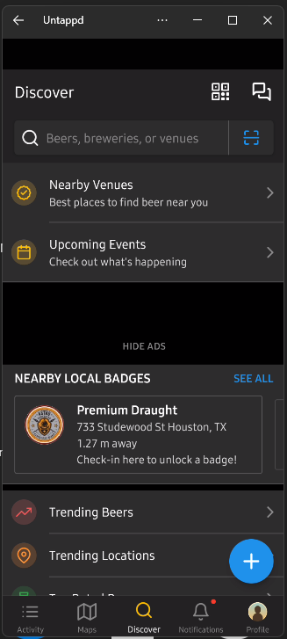
My personal nametag
In app communicator
“Search for a beer”
New experiences
In app ads
Community
information
“Search for a beer”
User/profile tools

Slide 2
New element
Past Experiences >
Redundant and floats over other elements

